Slide 1




CHALLENGE 15
Project Data Analytics Community
The Risk Takers

Slide 2

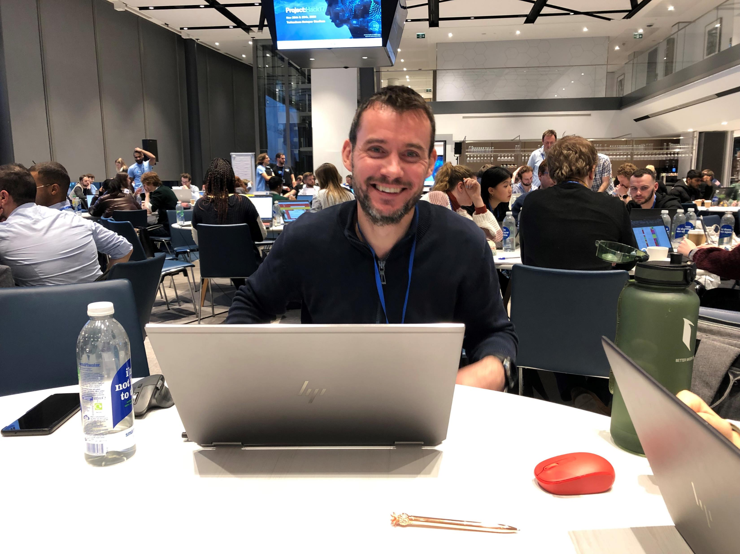
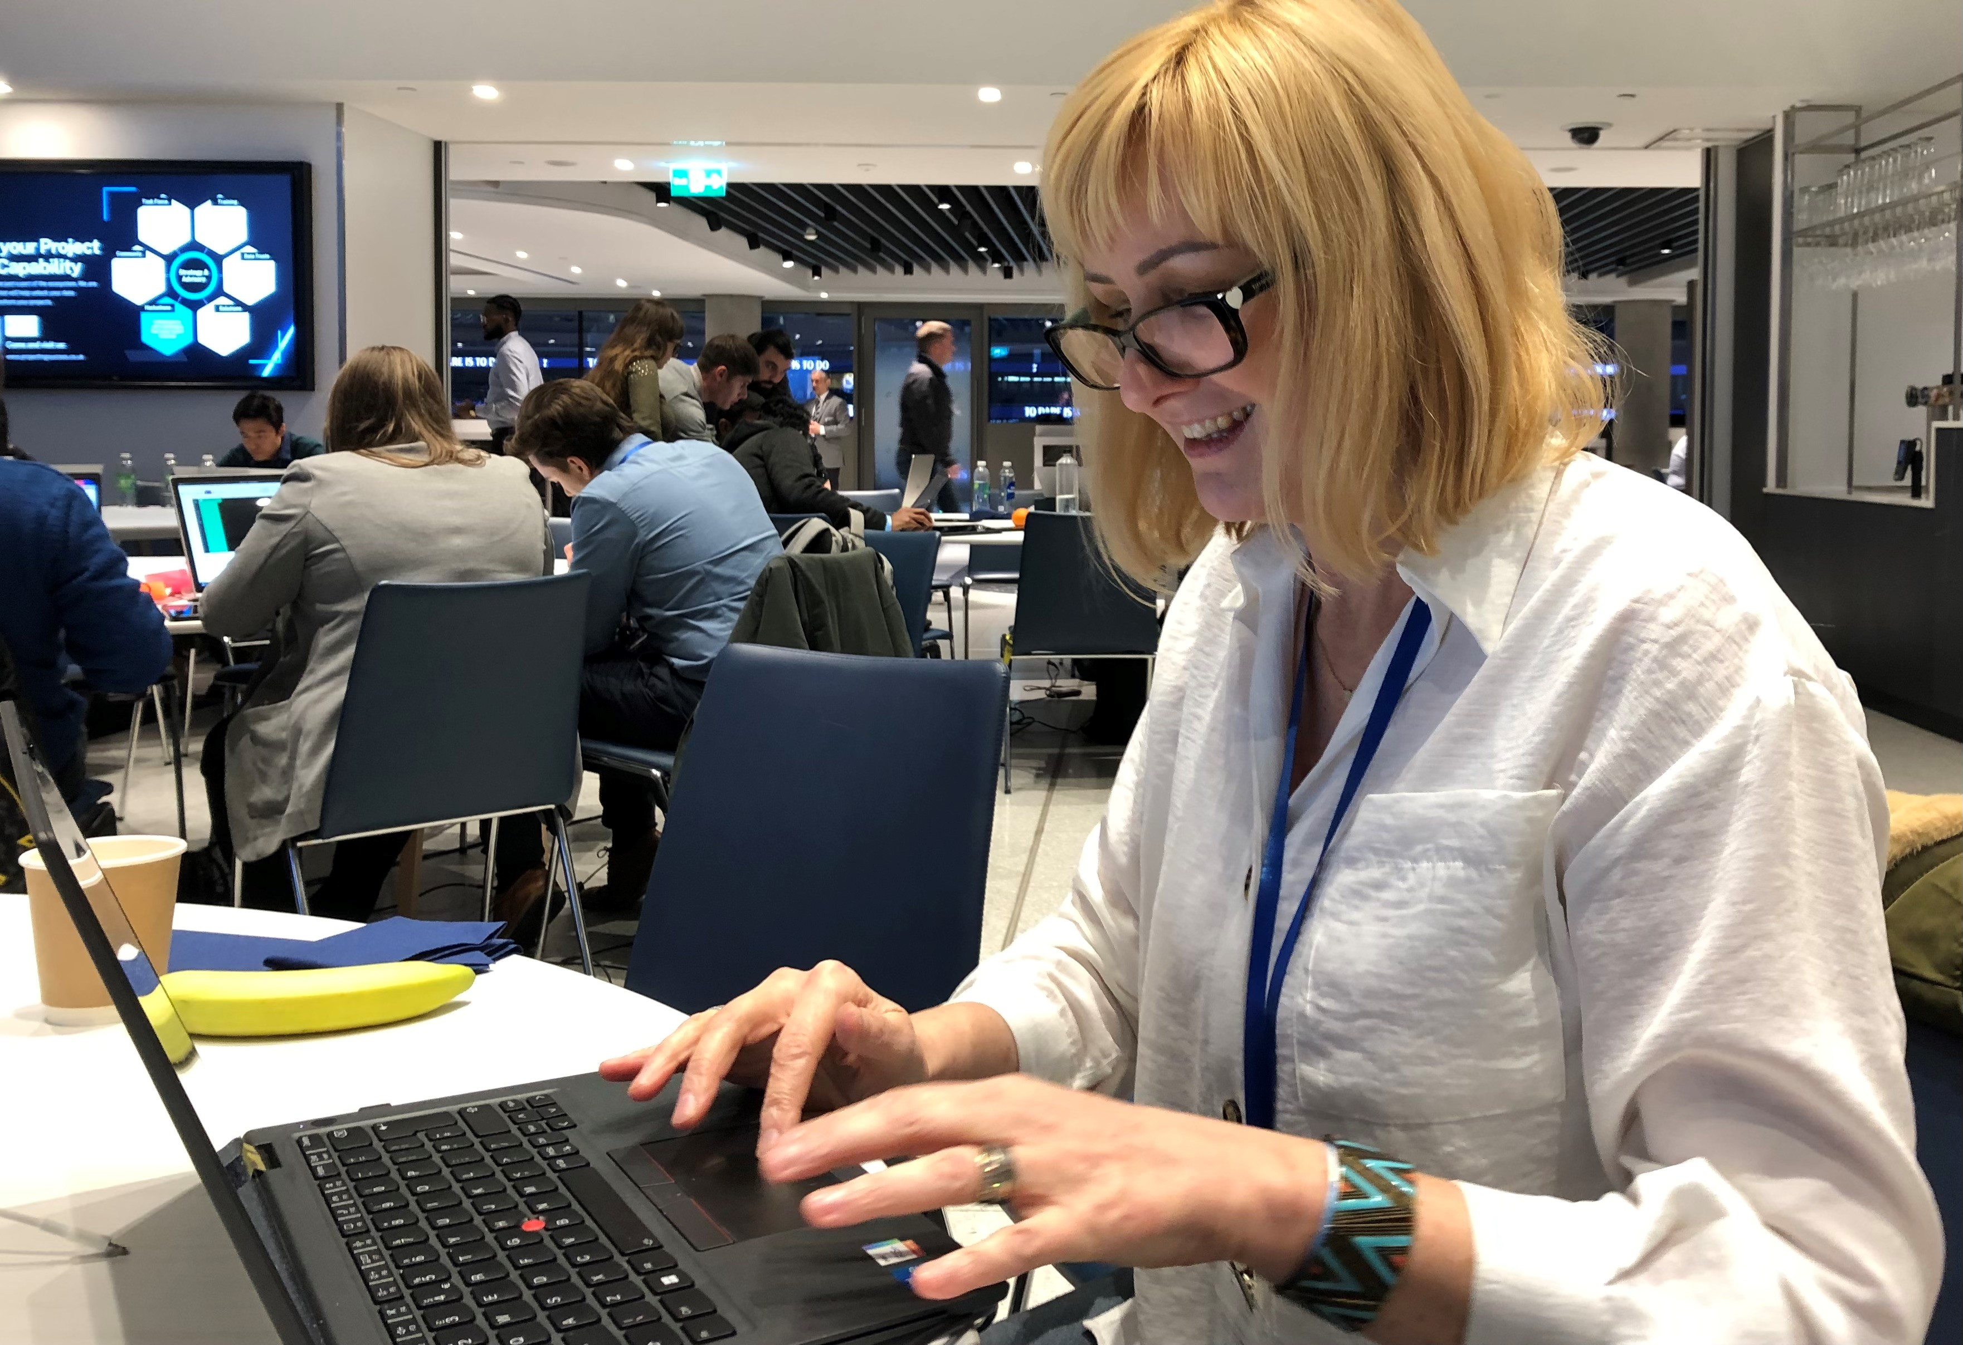
THE RISK TAKERS – TEAM 15A
Team Captain – Jessica Hyland
Octavius Infrastructure Ltd
Alex Elderton
VolkerFitzpatrick
Nadia Kaminska
Gleeds

Slide 3


CHALLENGE SUMMARY
Proactive risk management and opportunity realisation is vital to ensuring projects success. However, often the risk process is sluggish, overbearing, not accessible to all and not ‘live’. This challenge is about dramatically improving the agility of the risk process, by providing the project delivery community instant access to the latest risk content and the ability to update at any time.
We needed to ensure the front-end is concise and intuitive, so it encourages proactive updates from project professionals, whilst the supporting database aggregates and filters the relevant data to produce forward looking risk dashboards, focussing attention on what truly needs to be done to mitigate risk or realise opportunities.

Slide 4

PROBLEM TO SOLVE
Risks are often only reviewed in periodic risk reviews, and these reviews are often looking back, i.e. ‘rear-view mirror’ approach.
Registers are held on a database or excel spreadsheet and are only accessible to the risk professional.
Risk data is often outdated, with no consequence if due dates are missed.
Aggregation and roll-up of risk from project to programme/portfolio to corporate levels are often very manual.
Risk dashboards are often RAG/Top 5 outputs, which don’t provide much value or call for action/decision from SLTs.

Slide 5
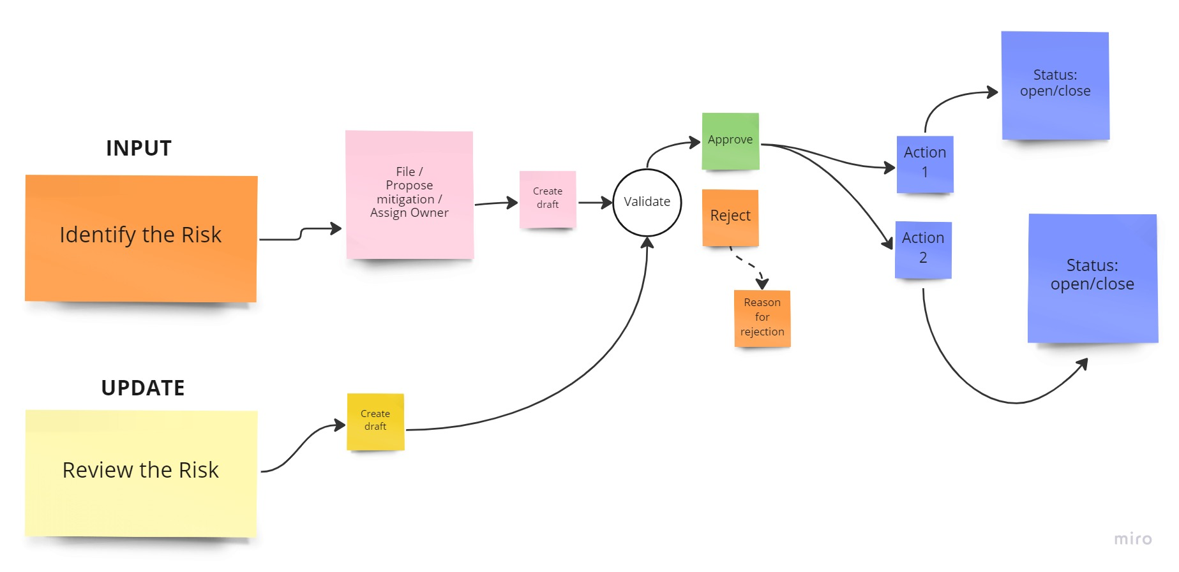
PROCESS FLOW

Slide 6



PRIMARY USERS' STORIES
Risk management professionals
Level of control over a risk process
Improved process, wide engagement
Live updates & prompting due actions
Prompting risks that are escalating
Accessible user interface portal
Assurance that data is collected & aggregated centrally
Ability to verify the data before dashboards are produced
Project professionals
Input new risk data
Update existing actions/risks at any time on site/on commute
Receive discrete notifications when actions are due
Project / Programme Leader
Forward looking risk management data
Concise and articulated details on how to mitigate risks
Consideration on efficiencies, savings and acceleration

Slide 7
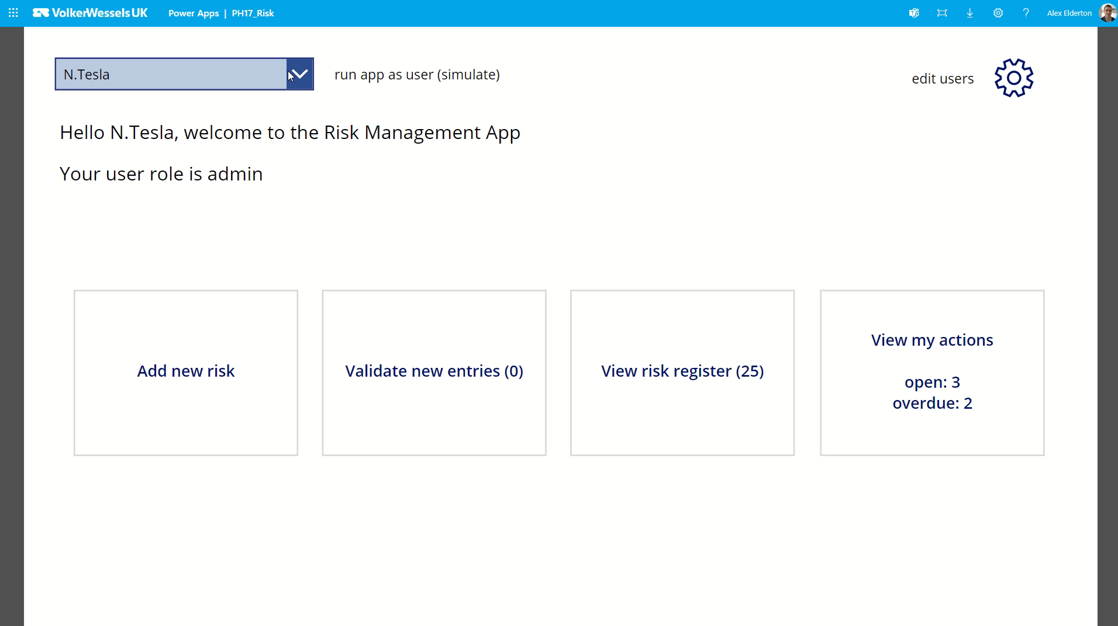

Slide 8
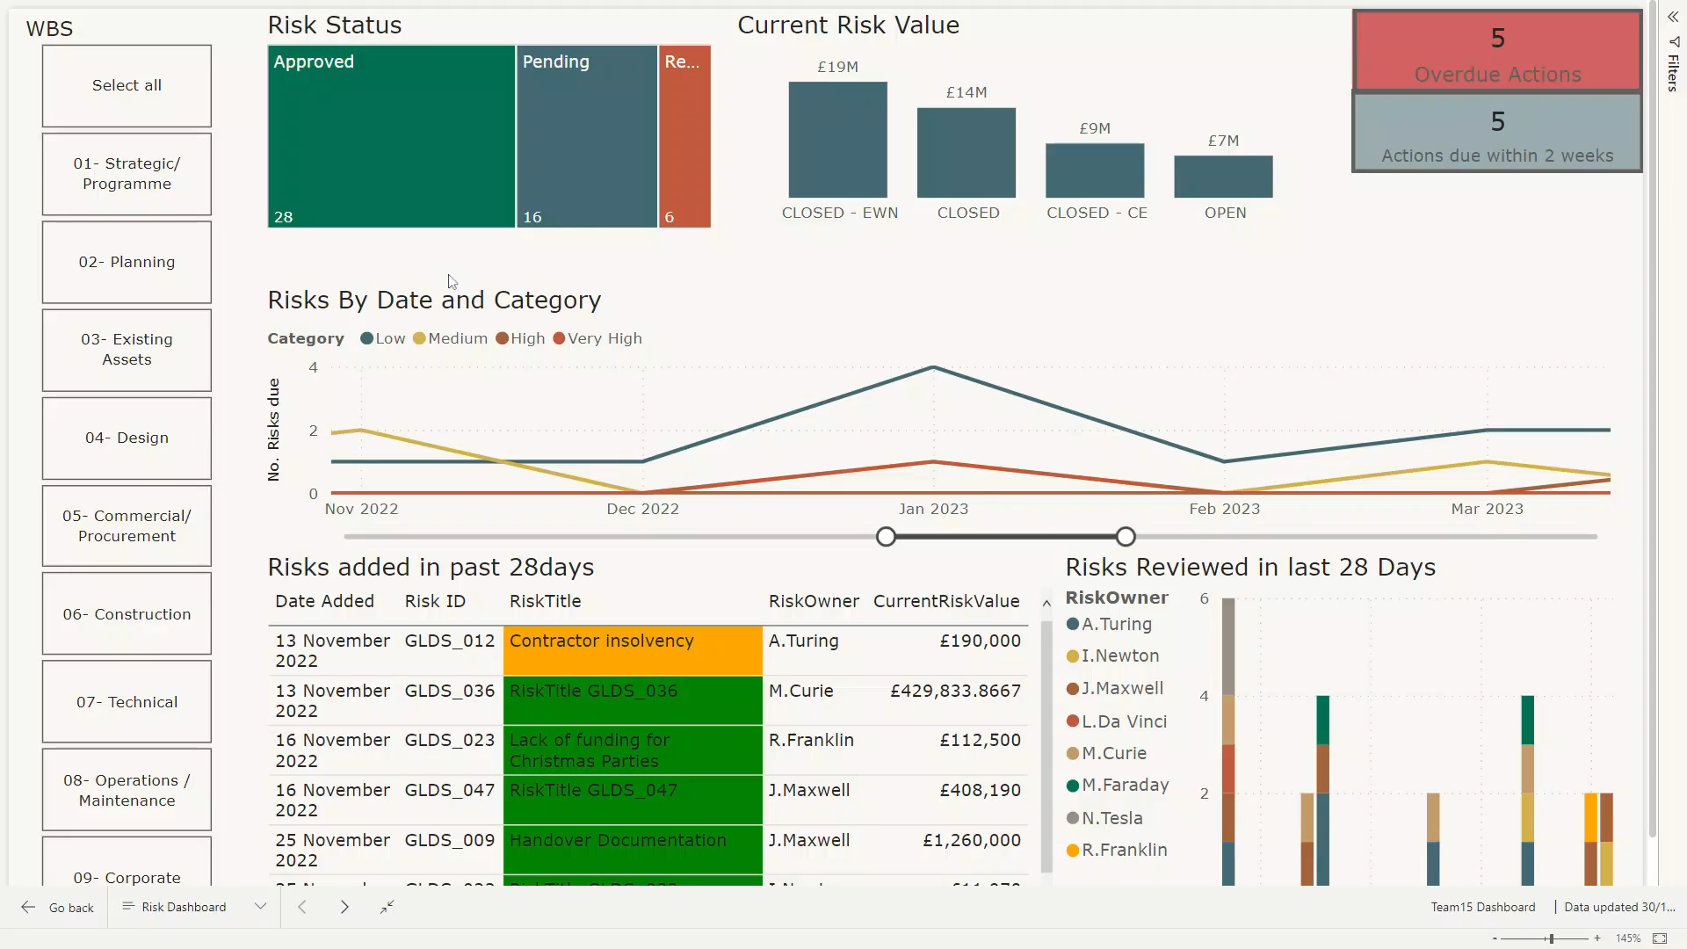


Slide 9
JUDGE’S QUESTIONS
Question 1:
How will your solution allow for making better informed future decisions, rather than the current retrospective risk review approach?
Question 2:
How have you ensured that due dates are met so that the risk data is kept up-to-date?
Question 3:
With more time available, what would you do differently to improve the solution?
Answer:
Cloud based data and multidevice applications promotes better behaviours and more frequent interactions with the risk register and action management rather than waiting for a risk review meeting to update previous actions / risks
Answer:
Notifications and reports side on the application / dashboard will provide nudges to action owners when actions are due, updates can be made ad hoc rather than monthly
Answer:
Refer to the next slide

Slide 10








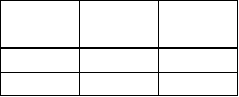
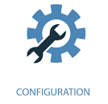
Potential Features
Current Features
Automated email Notifications & Reports
Cloud Planning Data Integration
User Roles
Risks
Actions
Notification Config

